Slide 1
Unsupervised Domain Adaptation for Urban Scene Understanding in Autonomous Driving
Project Proposal – Computer Vision Course
Dr. Yehudit Aperstein
Gal Hanuna, 205857675
Sefi Perez, 211485891

Slide 2
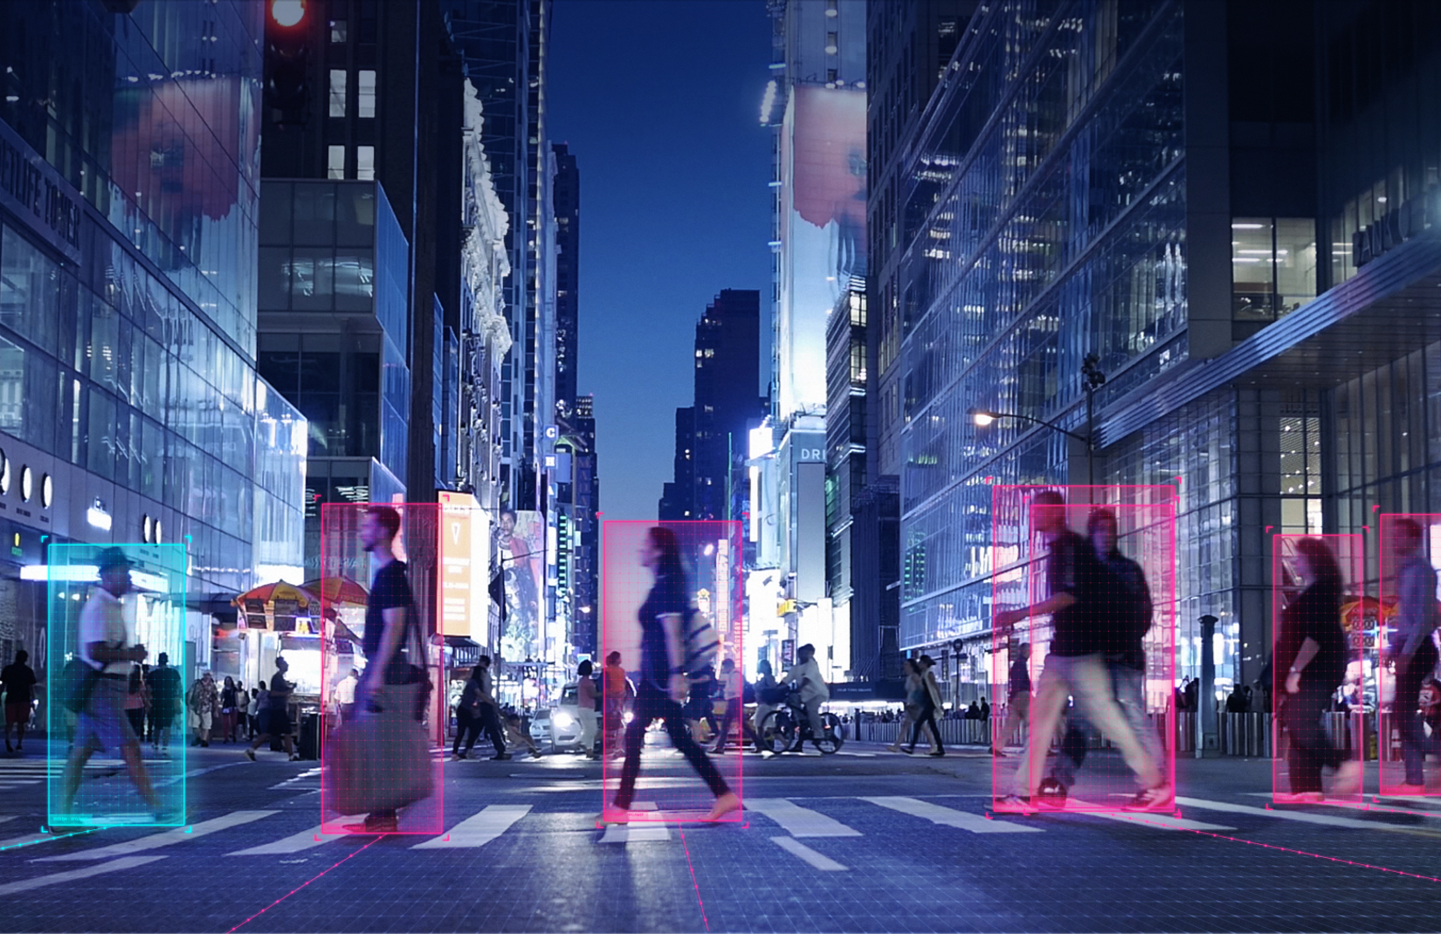
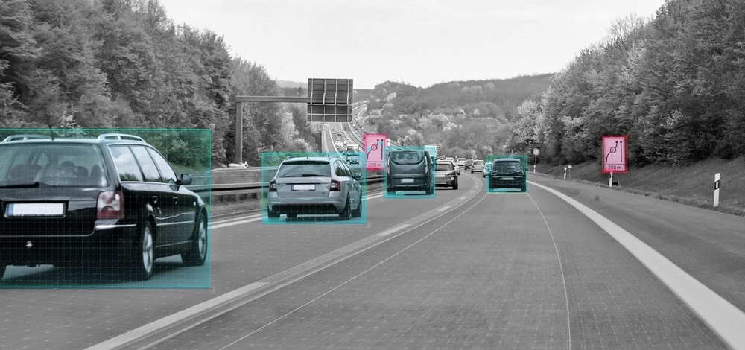
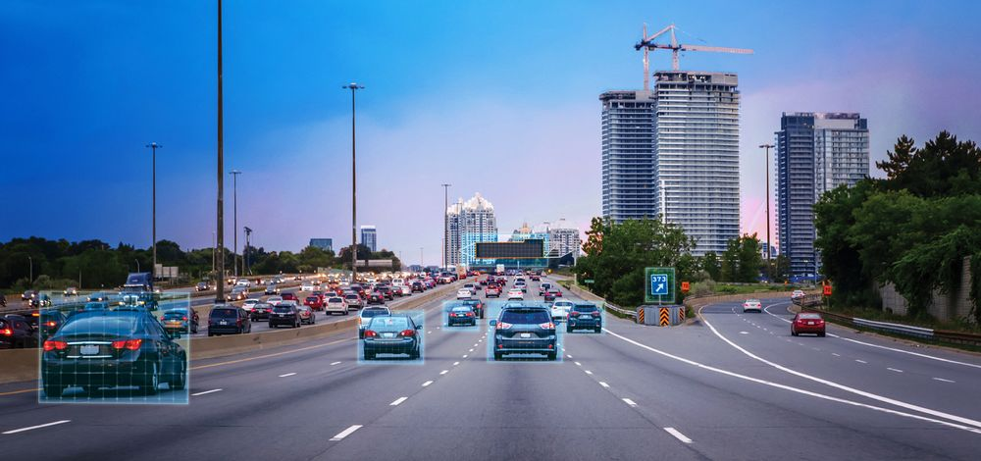
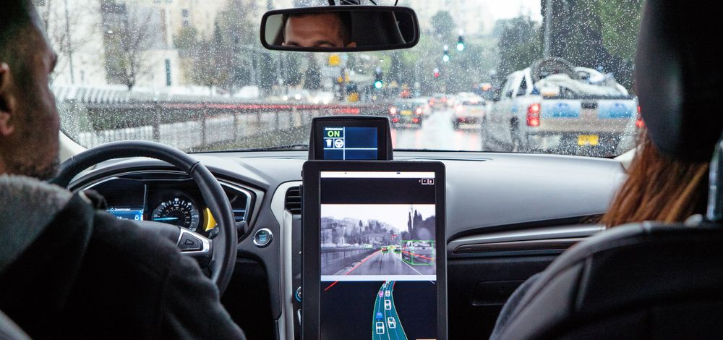
Autonomous Driving

Slide 3
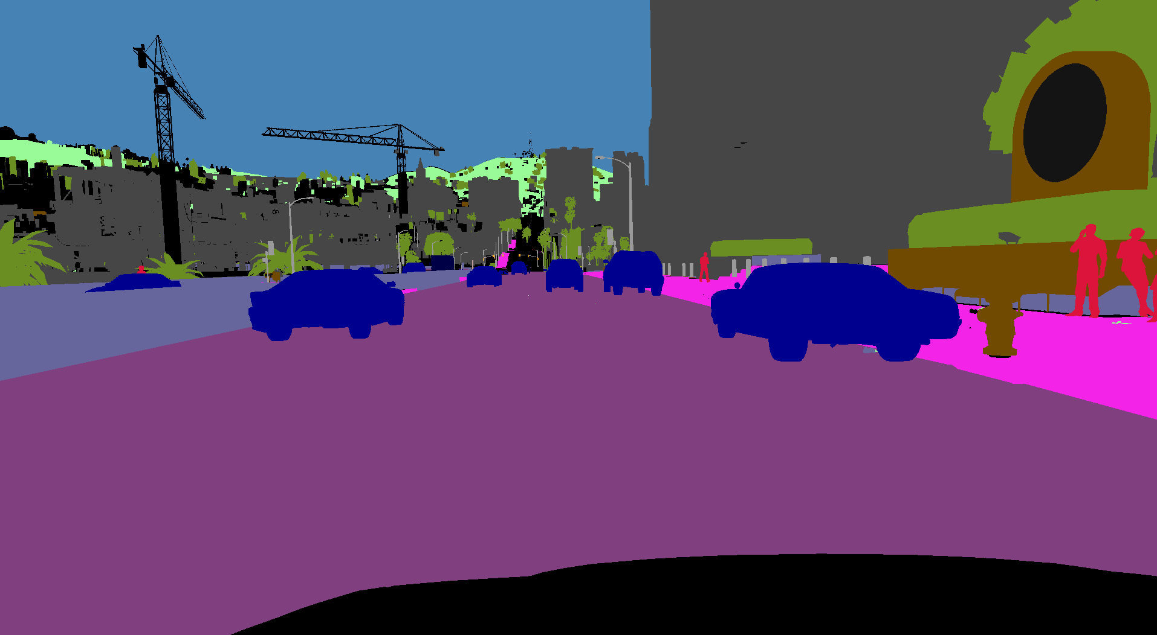
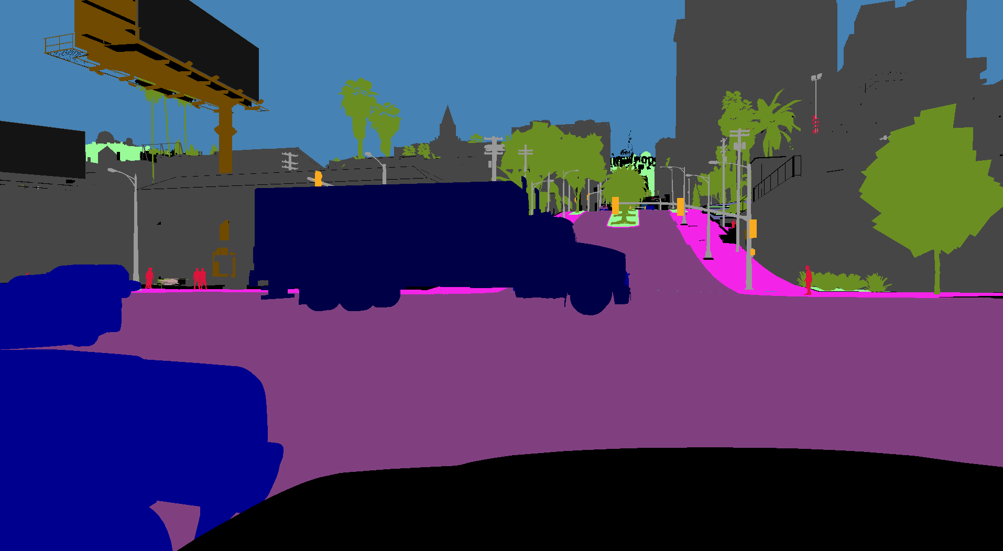
Motivation
Developing perception systems requires large labeled datasets, which take significant time and resources to create.
In many regions, data collection is limited by privacy rules, regulations or dependence on external cooperation.
Models trained in one country often struggle when deployed in a different environment and may require additional adaptation.
Performance also drops under challenging weather conditions such as fog, rain, snow or nighttime.
Collecting and labeling data for every possible environment and condition is unrealistic and costly.
Goal:
Enable models to adapt automatically to new domains without additional labeled data.

Slide 4
The Domain Shift Problem
Domain shift occurs when visual conditions differ between source and target domains (weather, lighting, architecture, camera). Models trained on one domain often fail on another.

Slide 5
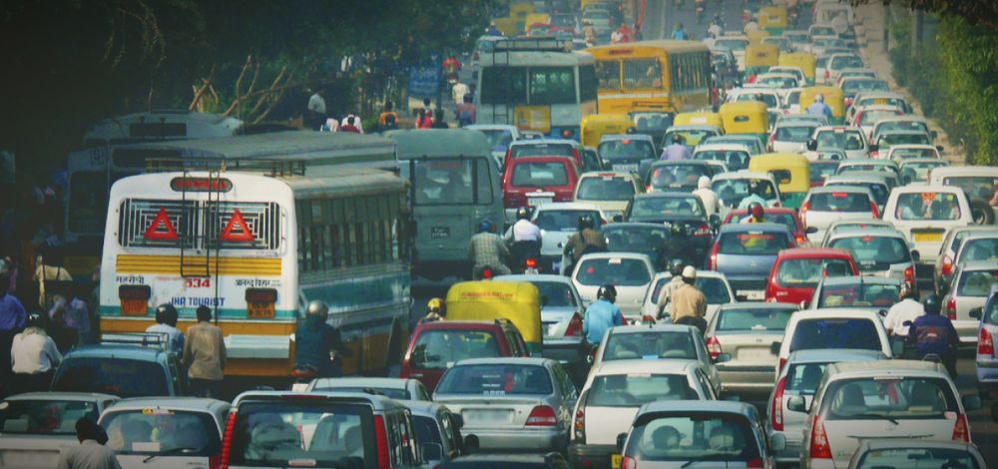
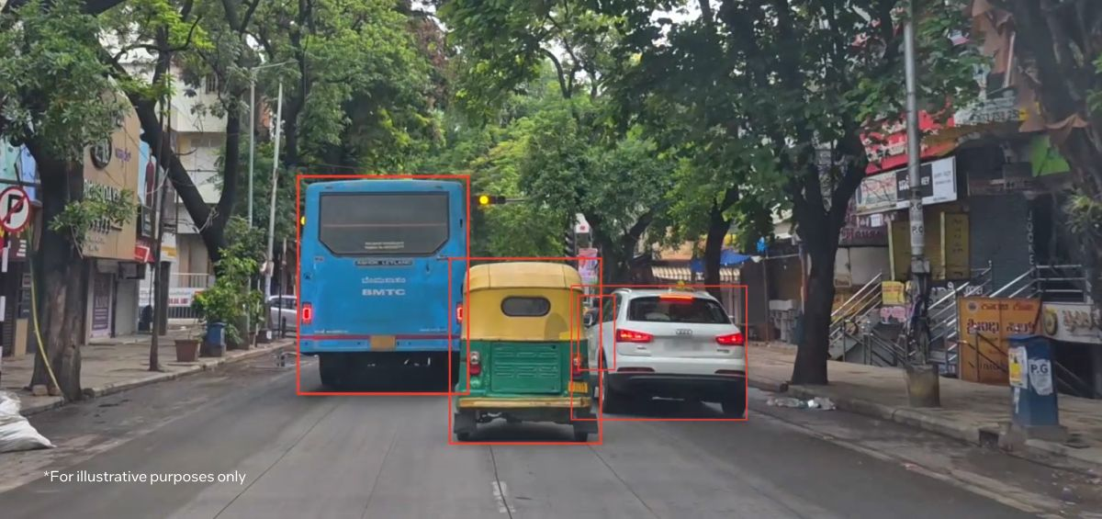
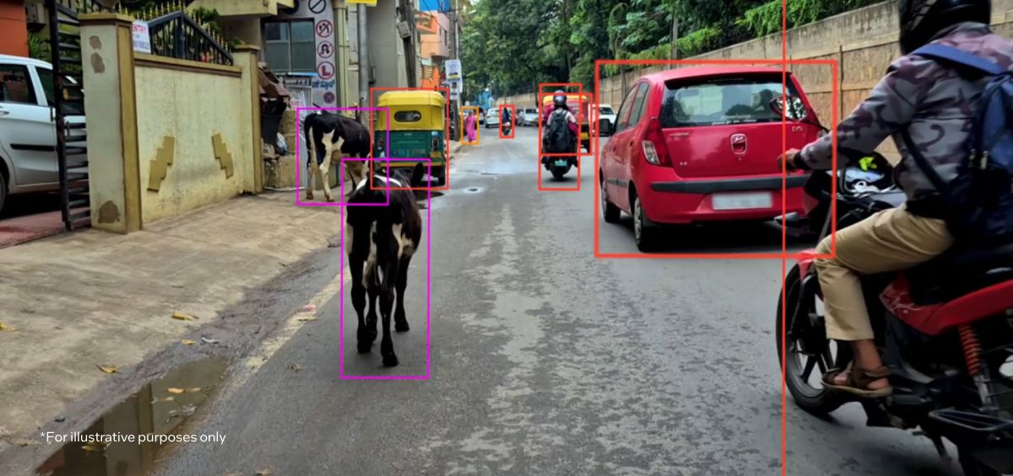
The Domain Shift Problem
India Road

Slide 6
Unsupervised Domain Adaptation (UDA)
Unsupervised domain adaptation (UDA) refers to the machine learning challenge where a model is trained using labeled data from a source domain and adapted to perform effectively on a target domain for which no labeled data are available.
Source Domain (Labeled)
Adaptation Process
Target Domain (Unlabeled)

Slide 7
Research questions
How much does segmentation accuracy decline when transferring to a new domain, and can unsupervised domain adaptation improve it?
suggestions for further work:
Does adaptation to one target improve generalization to a third domain?
Which visual factors (night, rain, fog, camera angle) cause the largest degradation?

Slide 8
Methodology
Source Dataset
train baseline
Baseline Segmentation Model
apply UDA
Target Dataset

Slide 9





Datasets
Cityscapes
Real, labeled
German urban scenes
Source domain
BDD100K
Real, unlabeled
Diverse U.S. driving scenes
Target domain
ACDC
Real, unlabeled
Adverse weather conditions
Optional target
GTA5
Synthetic, labeled
Game-engine urban scenes
Alternative source
Waymo Open
Real, partially labeled
Multi-city, camera + LiDAR
Additional evaluation

Slide 10
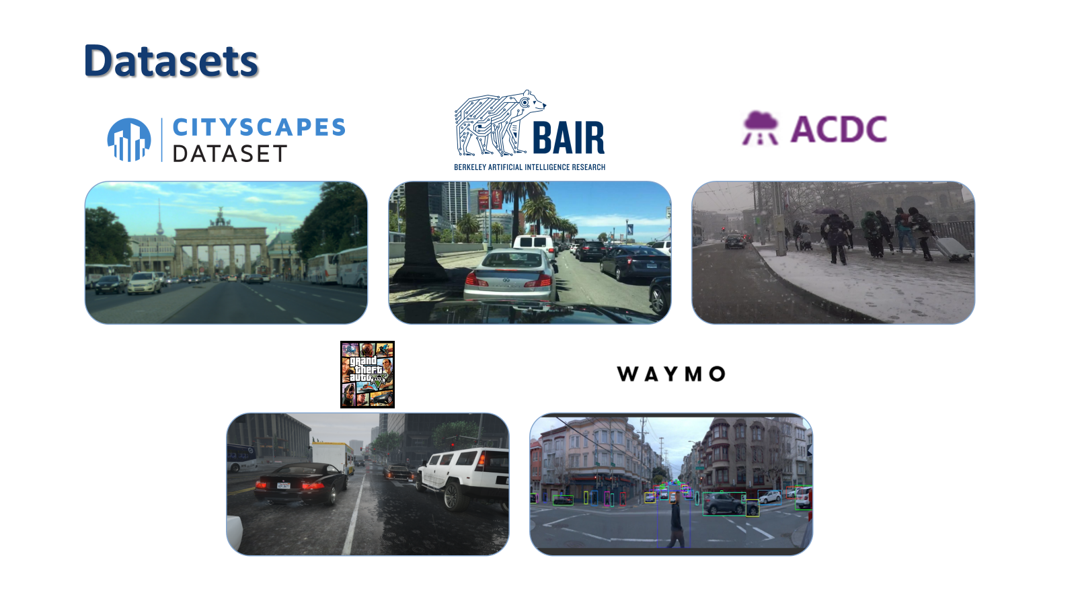

Slide 11
Impact & Contribution
Reduce the need to collect and manually annotate data when deploying models in new environments.
Improve model robustness when facing different visual conditions (new cities, weather, sensors).
Enable faster, more efficient and less expensive adaptation of perception systems to new domains.

Slide 12
Literature reivew

Slide 13
DAFormer: Domain Adaptation for Semantic Segmentation
Lukas Hoyer, Dengxin Dai, Luc Van Gool | March 2022
Unsupervised Domain Adaptation (UDA) for semantic segmentation
Train on synthetic driving data, test on real street images
Handle domain shift without new manual labels on the target domain

Slide 14
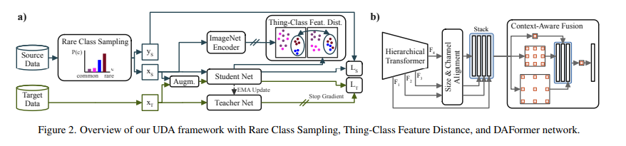
DAFormer: Domain Adaptation for Semantic Segmentation
Lukas Hoyer, Dengxin Dai, Luc Van Gool | March 2022
DAFormer
Combines a transformer-based encoder with a segmentation decoder
Uses teacher-student learning with pseudo labels on target images
Applies strong/weak augmentations and feature-distance regularization
Adds rare-class sampling to improve performance on less common classes

Slide 15
DAFormer: Domain Adaptation for Semantic Segmentation
Lukas Hoyer, Dengxin Dai, Luc Van Gool | March 2022
Experiments & Evaluation
Trained on GTA5/SYNTHIA and adapted to Cityscapes
Shows higher accuracy than previous UDA methods
Main metric: Mean Intersection-over-Union (mIoU) on Cityscapes (reported for source-only, DAFormer (UDA), and Fully supervised Cityscapes).
Other evaluation methods:
UDA vs supervised performance on Cityscapes ratio
IoU per class, with focus on rare classes (train, bus, truck, etc.)
mIoU improvement over previous UDA methods

Slide 16
DAFormer: Domain Adaptation for Semantic Segmentation
Lukas Hoyer, Dengxin Dai, Luc Van Gool | March 2022
Conclusions
Combining a transformer encoder with simple training strategies improves UDA
DAFormer produces more reliable pseudo labels and more stable adaptation
Does not rely on heavy adversarial training, easier to use in practice
Shows that models can handle domain shift without labeled data in the target domain, which is important for real driving systems

Slide 17
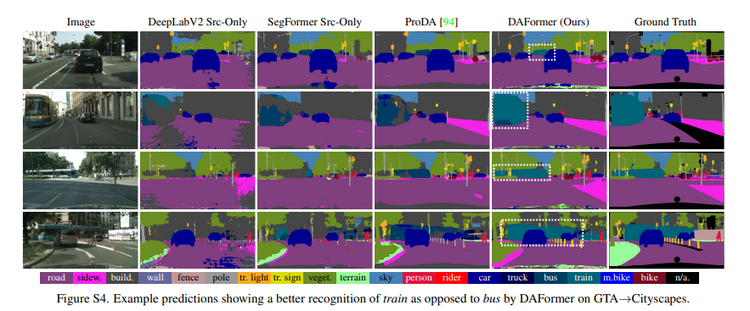
DAFormer: Domain Adaptation for Semantic Segmentation
Lukas Hoyer, Dengxin Dai, Luc Van Gool | March 2022

Slide 18
Divide, Ensemble and Conquer: The Last Mile on Unsupervised Domain Adaptation for Semantic Segmentation
Tao Lian, Jose L. G´omez, and Antonio M. L´opez. | June 2024
UDA for semantic segmentation is a challenge due to strong domain shift between synthetic images and real world data.
Models so far have tried using a single synthetic dataset to train, which limited their generalization. Using multiple synthetic sources is a challenge due to labeling mismatch.
The model proposed (DEC) uses Ensemble learning and divides the label space from multiple datasets.
Related works on Ensemble Learning and UDA for semantic segmentation.

Slide 19
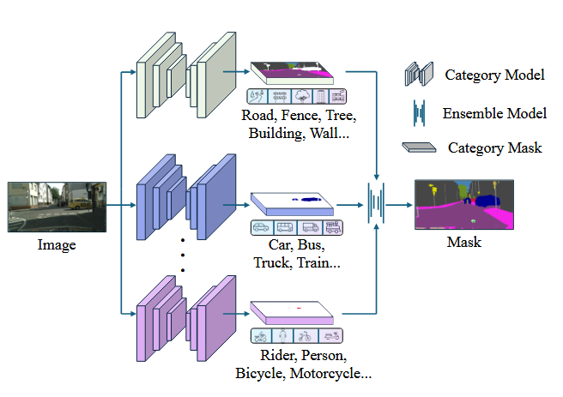
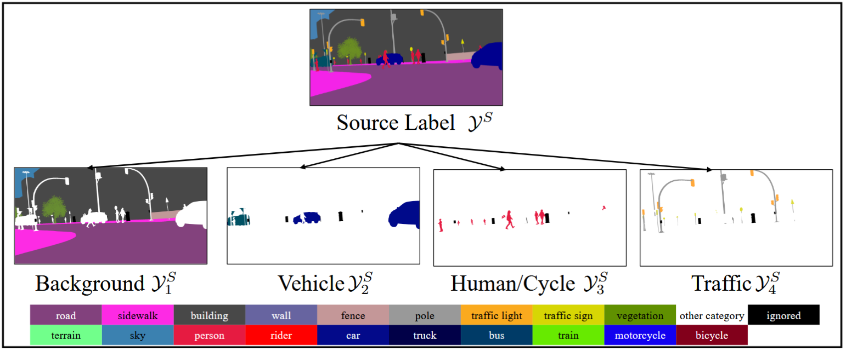
Divide, Ensemble and Conquer: The Last Mile on Unsupervised Domain Adaptation for Semantic Segmentation
Tao Lian, Jose L. G´omez, and Antonio M. L´opez. | June 2024

Slide 20
Divide, Ensemble and Conquer: The Last Mile on Unsupervised Domain Adaptation for Semantic Segmentation
Tao Lian, Jose L. G´omez, and Antonio M. L´opez. | June 2024
Divide - take all the labels from other datasets, turn into one of 4 general labels using ‘category models’ that are trained on multiple datasets.
Ensemble - take the output from the category models and combine them into a segmentation mask. Important: never deals with RGB images, only category masks, helps with generalization.
Conquer - apply the trained models to real world data.
Metrics: mloU (Mean Intersection over Union), loU. Measures the general and per class accuracy.

Slide 21
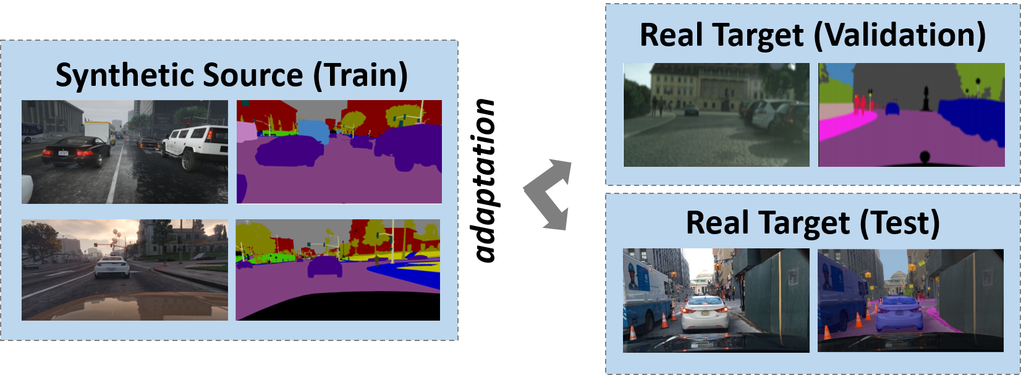
Multi-Target Unsupervised Domain Adaptation for Semantic Segmentation without External Data
Yonghao Xu, Pedram Ghamisi, Yannis Avrithis. | May 2024
The Challenge: Moving from a synthetic domain to a real one.
The Problem:
Manual tagging is very expensive,
Beyond synthetic-real images,
The domain gap hurts performance.

Slide 22
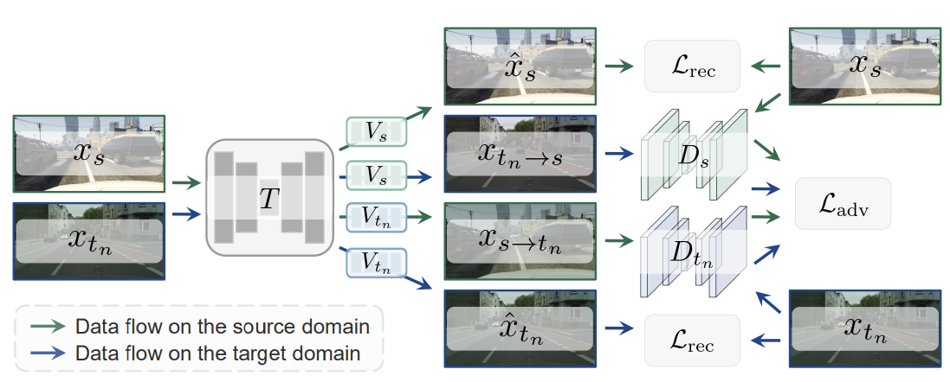
Multi-Target Unsupervised Domain Adaptation for Semantic Segmentation without External Data
Yonghao Xu, Pedram Ghamisi, Yannis Avrithis. | May 2024
The Solution: Perform the DEC steps:
Divide → Train → Ensemble → Conquer

Slide 23
Multi-Target Unsupervised Domain Adaptation for Semantic Segmentation without External Data
Yonghao Xu, Pedram Ghamisi, Yannis Avrithis. | May 2024
Conclusions:
Working on different models (Cityscapes, BDD100K, Mapillary Vistas, etc.),
Approaching supervised performance,
Can integrate with existing UDA methods.
Because UT-KD does not rely on external data at adaptation time, it is much more scalable and privacy-friendly and yet it still recovers close to 100% of the mIoU performance that the full external-data method (MT-KD) achieves.

Slide 24
Methodology

Slide 25
Model Selection
DAFormer (Hoyer et al., 2022)
Transformer-based encoder with a simple decoder
Teacher–student training with pseudo labels on target images
Strong / weak data augmentation for more robust adaptation
Rare-class sampling to improve under-represented classes
Achieves high mIoU on GTA5 → Cityscapes benchmarks
Multi-Target UDA (Xu et al., 2024)
One model adapted to multiple target domains
Uses knowledge distillation from source + previous targets
Can adapt to a new target using only its unlabeled data
Designed to be scalable and privacy-friendly (no external data at test time)
Reaches mIoU close to fully supervised performance on several datasets

Slide 26
Datasets and Workflow
Step | Source | Target (UDA) | Evaluation
Pretraining | GTA5 (labeled) | Cityscapes (unlabeled) | Cityscapes
Second adaptation | Cityscapes model | ACDC (unlabeled) | ACDC (per weather)

Slide 27
Experiments
Trained DAFormer with UDA from GTA5 to Cityscapes:
Source (labeled): GTA5
Target (unlabeled): Cityscapes
Evaluate the adapted model on:
Cityscapes validation set
ACDC (overall and per weather condition)
Start from the UDA-trained GTA5 to Cityscapes model.
Perform a second UDA step using ACDC as target:
Initialization: Cityscapes-adapted model
Target (unlabeled): ACDC

Slide 28
Evaluation
Evaluate on ACDC using its ground-truth labels.
Here we focus on ACDC per weather condition:
ACDC subsets: each weather condition is a separate subfolder containing its own images and ground-truth
Subset | Description | Example Challenge
fog | Images with reduced visibility and contrast | hard to distinguish far objects
rain | Rain streaks and reflections | noisy textures, glare
snow | White / overexposed scenes | low color contrast
night | Low-light or artificial illumination | poor object visibility, noise

Slide 29
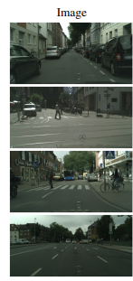
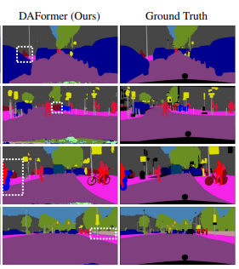
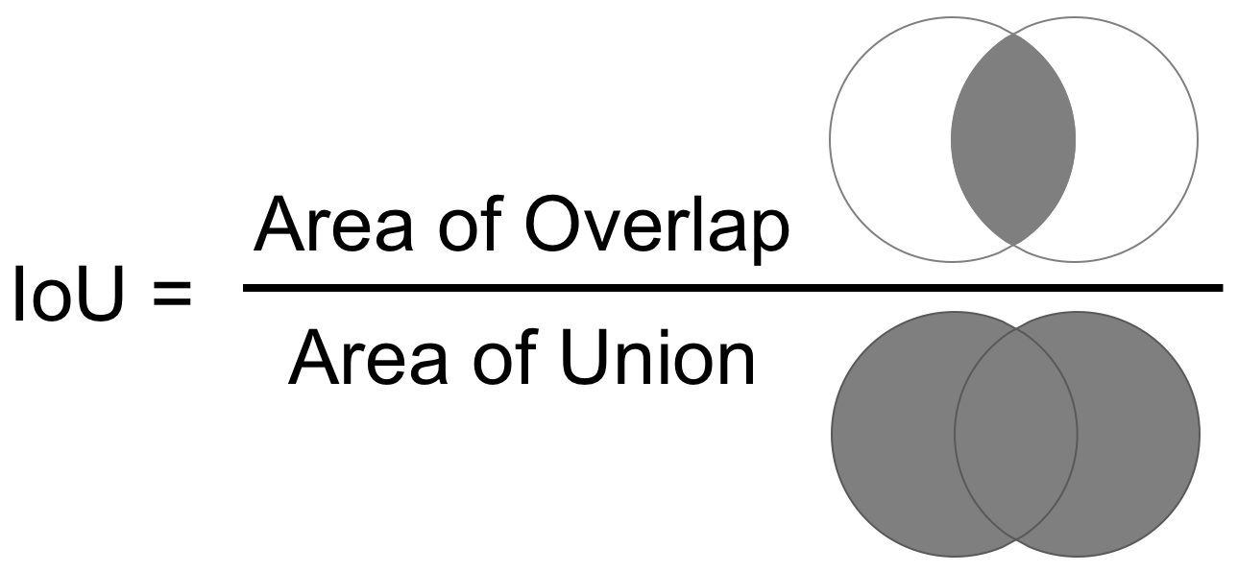
Evaluation
Compute mIoU for each subset for all three models:
Source-only
One-step UDA (GTA5→Cityscapes)
Two-step UDA (GTA5→Cityscapes→ACDC)

Slide 30
Research Question
This allows us to answer:
Which weather conditions are hardest for UDA, and how much does the second adaptation step to ACDC help?

Slide 31
Related Work
What existing works do:
CISS, CoDA, ControlUDA, etc.
Mostly do one step UDA from Cityscapes directly to ACDC (normal to adverse).
Yang et al. (AAAI 2024)
Do sequential multi-target UDA, but always with Cityscapes as the original labeled source and ACDC splits (night, rain, fog, snow) as sequential targets.
They study how to avoid forgetting when adapting across multiple ACDC weathers.
They don’t start from a synthetic to Cityscapes UDA model.
There’s no explicit “second adaptation step to ACDC after synthetic to Cityscapes”.

Slide 32
Related Work
ACDC dataset introduces four adverse conditions – fog, rain, snow, night – and shows a strong drop in segmentation accuracy under these conditions compared to normal weather.
Recent UDA methods (Cityscapes to ACDC) report per-weather mIoU and consistently find that night and dense fog are the hardest conditions, while rain and snow are easier.
Multi-target / sequential UDA approaches adapt a model across several ACDC weather domains and study forgetting and knowledge retention when moving from one weather condition to another.
Forgetting and knowledge retention refer to how much a model loses or preserves its performance on earlier weather conditions after being further adapted to new ones.

Slide 33
Our Work
Starts from a synthetic to Cityscapes UDA model (matching the standard DAFormer setup).
Adds a second UDA stage to ACDC and compares performance per weather before vs after this stage.
Focuses on:
How much extra benefit do we get from adapting a Cityscapes-UDA model to ACDC?
Which ACDC conditions remain the hardest even after this second step?

Slide 34
Papers
https://openaccess.thecvf.com/content_CVPRW_2019/papers/WAD/Biasetton_Unsupervised_Domain_Adaptation_for_Semantic_Segmentation_of_Urban_Scenes_CVPRW_2019_paper.pdf?utm_source=chatgpt.com
https://arxiv.org/pdf/2111.14887
https://ieeexplore.ieee.org/stamp/stamp.jsp?arnumber=10973315
https://arxiv.org/pdf/2406.18809
https://arxiv.org/pdf/2307.09676
https://repositorio.unesp.br/server/api/core/bitstreams/46f72f98-aaec-4b99-aca9-fcf55790fda2/content
https://arxiv.org/pdf/2405.06502
https://ieeexplore.ieee.org/stamp/stamp.jsp?arnumber=10839383

Slide 35
Thank you for listening
Questions?

